Slide 1
BOOSTING ALGORITHM
Dr. N DILIP RAJA

Slide 2
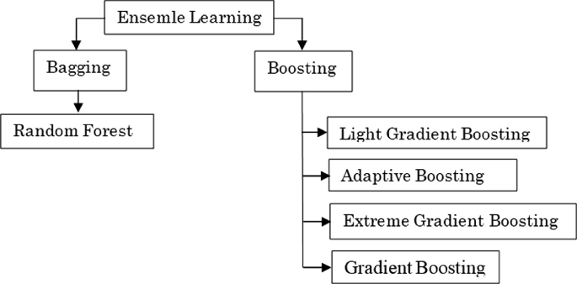
ENSEMBLE LEARNING LAYOUT

Slide 3
What is boosting algorithm ?
Just as humans learn from their mistakes and try not to repeat them further in life, the Boosting algorithm tries to build a strong learner (predictive model) from the mistakes of several weaker models
AdaBoost
XGBoost
LGBoost
Types of Boosting Algorithms

Slide 4




Prerequisites
Supervised Machine Learning
Ensemble Learning
Gradient Boosting
Tree Based Machine Learning Algorithms

Slide 5
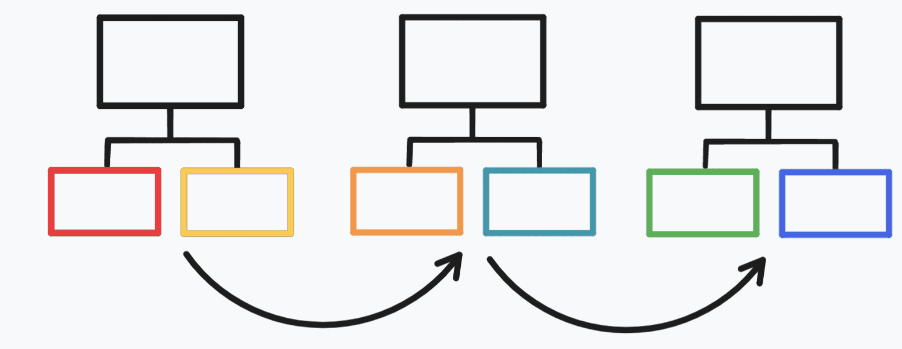
Ada boost
Also called as
Adaptive Boosting
Best out-of-the-box classifier
Formulated by
Yoav Freund and Robert Schapire
1995

Slide 6
Three basic ideas of Adaboost
Combines a lot of weak learners to make the classification.
These weak learners are called a stump.
Some stumps get more influence compared to other stumps during classification.
Each stump is made by taking the previous stump’s mistakes into account.

Slide 7
What is Ada boost ?
Adaboost (short for adaptive boosting) is an ensemble learning method (also known as “meta-learning”) which was initially created to increase the efficiency of binary classifiers.
Adaboost uses an iterative approach to learn from the mistakes of weak classifiers, and turn them into strong ones.
Adaboost is like a boon to improve the accuracy of our classification algorithms if used accurately.
It is the first successful algorithm to boost binary classification.
Adaboost is increasingly being used in the industry and has found its place in facial recognition systems to detect if there is a face on the screen or not.

Slide 8
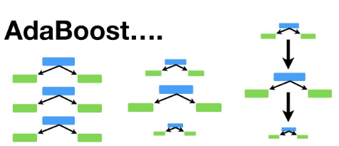

Slide 9
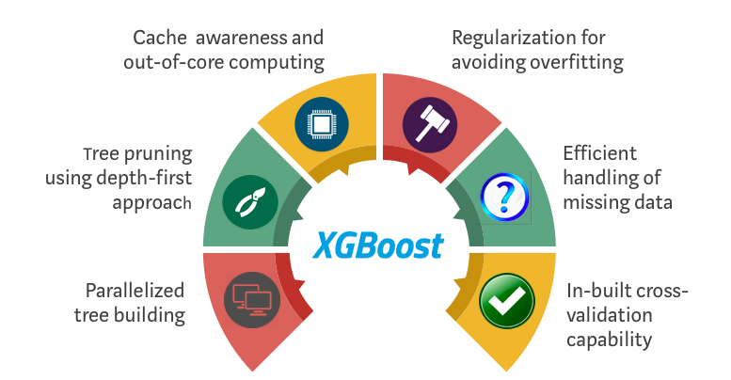
XGBoost
Also called as
Extreme Gradient Boosting

Slide 10
What is XG boost ?
XGBoost is an optimized distributed gradient boosting library designed for efficient and scalable training of machine learning models.
It has enhanced performance and speed in tree-based (sequential decision trees) machine learning algorithms.
It is an ensemble learning method that combines the predictions of multiple weak models to produce a stronger prediction.
it has become one of the most popular and widely used machine learning algorithms due to its ability to handle large datasets and
It has ability to achieve state-of-the-art performance in many machine learning tasks such as classification and regression.

Slide 11
Key features of XGBoost
Efficient handling of missing values, which allows it to handle real-world data with missing values without requiring significant pre-processing.
Has built-in support for parallel processing, making it possible to train models on large datasets in a reasonable amount of time
Can be used in a variety of applications, including Kaggle competitions, recommendation systems, and click-through rate prediction, among others.
Highly customizable and allows for fine-tuning of various model parameters to optimize performance

Slide 12
XGBoost Parameters
General parameters:
relate to which booster we are using to do boosting, commonly tree or linear model
Booster parameters:
depend on which booster you have chosen
Learning task parameters:
decide on the learning scenario. For example, regression tasks may use different parameters with ranking tasks.
Command line parameters:
relate to behavior of CLI version of XGBoost

Slide 13
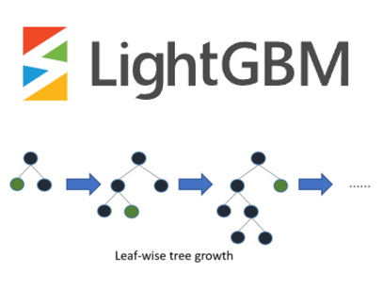
LGBoost
Also called as
Light Gradient Boosting

Slide 14
What is LG boost ?
a gradient boosting method, which constructs a strong learner by sequentially adding weak learners in a gradient descent manner.
It optimizes memory usage and training time with techniques like Gradient-based One-Side Sampling (GOSS).
optimizations like leaf-wise tree growth and efficient data storage formats, contribute to LightGBM’s efficiency and give it a competitive edge over other gradient boosting frameworks.

Slide 15
Key features of XGBoost
High-performance gradient boosting framework developed by Microsoft.
Designed for efficiency, scalability, and accuracy.
Based on decision tree designed to improve model efficiency and reduce memory usage.
Incorporates several novel techniques, including Gradient-based One-Side Sampling (GOSS), which
Selectively retains instances with large gradients during training to optimize memory usage and training time.
Employs histogram-based algorithms for efficient tree construction

Slide 16
LightGBM Core Parameters
Objective
task
num_leaves
learning_rate
max_depth

Slide 17
THANK YOU

